Slide 1

19-09-2019

Slide 2

Fixed cost, variable cost, and total cost
Marginal cost
Short run and long run
Shut-down and go-out-of-business decisions
Average cost
Graphing the AFC, AVC, ATC, and MC curves
The law of diminishing returns
Economies and diseconomies of scale
The long-run planning envelope curve

Slide 3

Sales - Costs = Profit
or
Total Revenue - Total Cost = Profit
or
Total Revenue
- Total Cost
Profit

Slide 4

Fixed cost stays the same no matter how much output changes
  Some examples of fixed cost are rent, insurance, salaries, property taxes, and interest payments
  Even when a firm’s output is zero, it incurs the same fixed cost
  Fixed costs are sometimes called “sunk cost” because once you have obligated yourself to pay them, that money has been sunk into your firm
  The trick is to spread these (fixed) cost over as much output as possible
    In other words, to spread your overhead over a large output

Slide 5

Variable costs “vary” with output
  Output rises, variable costs rise
  Output falls, variable costs fall
  Some examples of variable costs are wages of production workers, fuel, raw materials, electricity, and shipping
  A cost may be part fixed and part variable
    The electricity used by production is a variable cost because it will go up or down with production
    Even if your output fell to zero, you would still have to pay something on your electric bill

Slide 6

Total cost is the sum of fixed and variable cost
TC = FC + VC

Slide 7

Output FC VC TC
0 $1000 $ 0 $1000
1 1000 500 1500
2 1000 900 1900
3 1000 1300 2300
4 1000 1800 2800
5 1000 2400 3400
6 1000 3200 4200

Slide 8
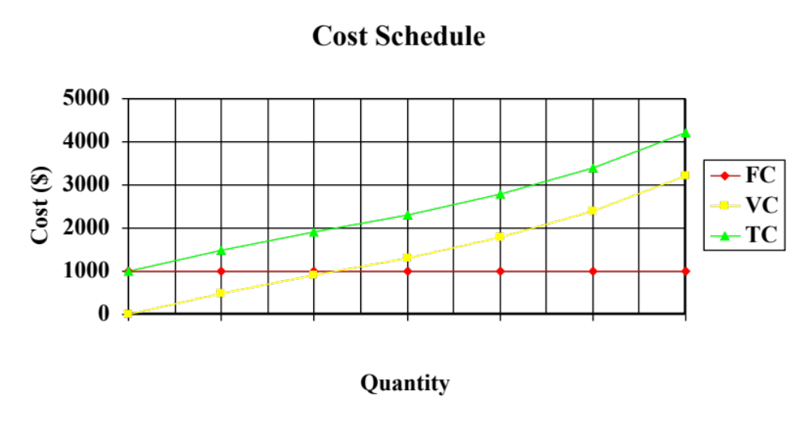
Output FC VC TC
0 $1000 $ 0 $1000
1 1000 500 1500
2 1000 900 1900
3 1000 1300 2300
4 1000 1800 2800
5 1000 2400 3400
6 1000 3200 4200
0 1 2 3 4 5 6

Slide 9
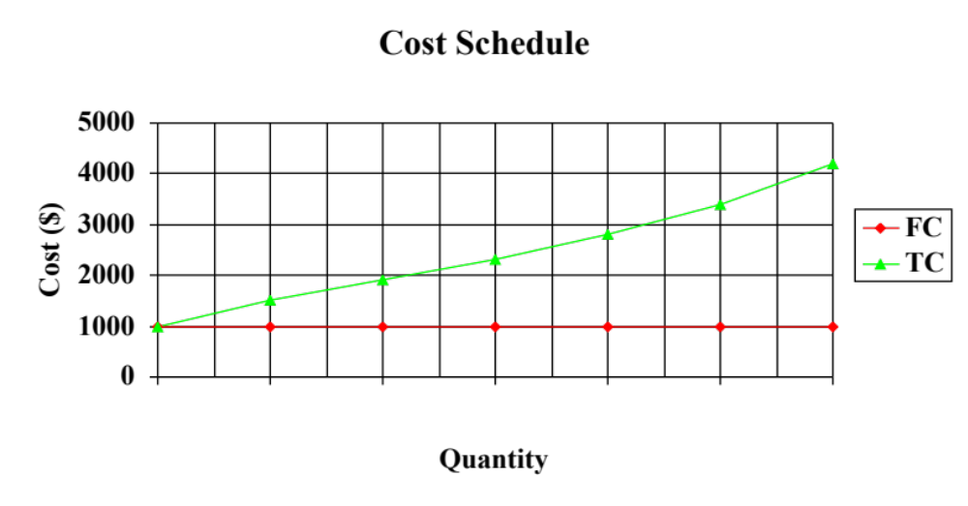
FC + VC = TC
The black vertical lines are the variable costs
0 1 2 3 4 5 6

Slide 10

Marginal cost is the cost of producing one additional unit of output
Output FC VC TC MC
0 $500 $ 0 $500 $ ---
1 200 700 200
2 300 800 100
3 450 950 150
4 650 1,150 200
5 950 1,450 300
6 1,500 2,000 550

Slide 11
Marginal cost is the cost of producing one additional unit of output
Output FC VC TC MC
0 $500 $ 0 $500 $ ---
1 200 700 200
2 300 800 100
3 450 950 150
4 650 1,150 200
5 950 1,450 300
6 1,500 2,000 550
At an output of zero VC is always zero

Slide 12
Marginal cost is the cost of producing one additional unit of output
Output FC VC TC MC
0 $500 $ 0 $500 $ ---
1 200 700 200
2 300 800 100
3 450 950 150
4 650 1,150 200
5 950 1,450 300
6 1,500 2,000 550
At an output of zero FC is equal to TC

Slide 13

As long as there are any fixed cost, we are in the short run
  The present time is always in the short run
The short run is the length of time it takes all fixed cost to become variable cost
  In other words, the length of time it takes to eliminate all fixed costs
    A steel firm might need a couple of years to pay of such fixed cost as interest and rent
    Even a grocery store would need a few weeks or months to sublet the store and discharge its other obligations

Slide 14

The long run is the time at which all cost become variable cost
  The long run never exist except in theory
    You will never have a situation in which all your cost are variable
    This would mean no rent, no insurance, no guaranteed salaries, no depreciation, etc
  You never really reach the long run
    As you proceed through the short run, you are forced to make decisions that will push the long run farther into the future

Slide 15

A firm has two basic options in the short run
  The firm can operate
    If it operates, it will produce the output that will yield the highest possible profits
    If it is losing money, it will operate at that output at which losses are minimized
  The firm can shut down
    If the firm shuts down, the output is zero
      Shutting down does not mean zero total costs
    The firm must still meet its fixed costs
      Remember, at an output of zero total cost equals fixed cost
    The firm can not go-out-of-business until all fixed cost obligations are eliminated

Slide 16
Problem 1 Problem 2 Problem 3 (All dollar figures in millions)
Fixed costs $ 5 $10 $ 8
Variable costs 6 9 12
Prospective Sales 7 8 10
Decision
Operate
Short Run Choices
Problem # 1 Decision - Operate or shut Down?
Operate
TC = FC + VC ($5 + $6) = $11
Sales = . . . . . . . . . . . . . . . . 7
Loss = . . . . . . . . . . . . . . . . $ 4
Shut Down
TC = (FC) = $5
Sales = . . . . . . 0
Loss = . . . . . . $5

Slide 17
Problem 1 Problem 2 Problem 3 (All dollar figures in millions)
Fixed costs $ 5 $10 $ 8
Variable costs 6 9 12
Prospective Sales 7 8 10
Decision
Operate
Shut down
Short Run Choices
Problem # 2 Decision - Operate or shut Down?
Operate
TC = FC + VC ($10 + $9) = $19
Sales = . . . . . . . . . . . . . . . . . . 8
Loss = . . . . . . . . . . . . . . . . . . $11
Shut Down
TC = (FC) = $10
Sales = . . . . . . 0
Loss = . . . . . . $10

Slide 18
Problem 1 Problem 2 Problem 3 (All dollar figures in millions)
Fixed costs $ 5 $10 $ 8
Variable costs 6 9 12
Prospective Sales 7 8 10
Decision
Operate
Shut down
Shut down
Short Run Choices
Problem # 3 Decision - Operate or shut Down?
Operate
TC = FC + VC ($8 + $12) = $20
Sales = . . . . . . . . . . . . . . . . . . 10
Loss = . . . . . . . . . . . . . . . . . . $10
Shut Down
TC = (FC) = $8
Sales = . . . . . . 0
Loss = . . . . . . $8

Slide 19
Problem 1 Problem 2 Problem 3 (All dollar figures in millions)
Fixed costs $ 5 $10 $ 8
Variable costs 6 9 12
Prospective Sales 7 8 10
Decision
Operate
Shut down
Shut down
In the short run . . . A firm has two options
The firm operates when sales exceed variable cost
The firm shuts down when variable cost are greater than sales
Note: Fixed costs are not relevant in the operate/shut down decision!

Slide 20

In the long run firms must decide to stay in business or go out of business
  The firm will stay in business if prospective sales are greater than its total cost
  The firm will go out of business if the total cost exceed prospective sales
    Going out of business means that all fixed cost obligations are met
Does everybody who is losing money go out of business?
  Eventually (most sooner rather than later)
  There are always exceptions to the rule

Slide 21

Output FC VC TC AFC AVC ATC MC
0 $500 $ 0 $500
1 500 200 700
2 500 300 800
3 500 420 920
4 500 580 1,080
5 500 800 1,300
6 500 1200 1,700
7 500 1900 2,400
TC = FC + VC

Slide 22
Output FC VC TC AFC AVC ATC MC
0 $500 $ 0 $500 $ -
1 500 200 700 500
2 500 300 800 250
3 500 420 920 166.7
4 500 580 1,080 125
5 500 800 1,300 100
6 500 1200 1,700 83.3
7 500 1900 2,400 71.4
AFC = FC / Output

Slide 23
Output FC VC TC AFC AVC ATC MC
0 $500 $ 0 $500 $ - $ -
1 500 200 700 500 200
2 500 300 800 250 150
3 500 420 920 166.7 140
4 500 580 1,080 125 145
5 500 800 1,300 100 160
6 500 1200 1,700 83.3 200
7 500 1900 2,400 71.4 271.4
AVC = VC / Output

Slide 24
Output FC VC TC AFC AVC ATC MC
0 $500 $ 0 $500 $ - $ - $ -
1 500 200 700 500 200 700
2 500 300 800 250 150 400
3 500 420 920 166.7 140 306.7
4 500 580 1,080 125 145 270
5 500 800 1,300 100 160 260
6 500 1200 1,700 83.3 200 283.7
7 500 1900 2,400 71.4 271.4 342.9
ATC = TC / Output

Slide 25
Output FC VC TC AFC AVC ATC MC
0 $500 $ 0 $500 $ - $ - $ - $-
1 500 200 700 500 200 700 200
2 500 300 800 250 150 400 100
3 500 420 920 166.7 140 306.7 120
4 500 580 1,080 125 145 270 160
5 500 800 1,300 100 160 260 220
6 500 1200 1,700 83.3 200 283.7 400
7 500 1900 2,400 71.4 271.4 342.9 700
MC is the cost of producing one additional unit of output
It is best to use the VC column to calculate the MC. If the TC column is used, you cannot calculate the MC for the first unit of output

Slide 26
Graphing the AFC, AVC, ATC, and MC curves
Output FC VC TC AFC AVC ATC MC
0 $500 $ 0 $500 $ 0 $ 0 $ 0 $ 0
1 500 200 700 500 200 700 200
2 500 300 800 250 150 400 100
3 500 420 920 167 140 307 120
4 500 580 1080 125 145 270 160
5 500 800 1300 100 160 260 220
6 500 1200 1700 83 200 283 400
7 500 1900 2400 71 271 343 700
Much of microeconomic analysis involves:
* filling in a table * drawing a graph * analysis of the graph

Slide 27
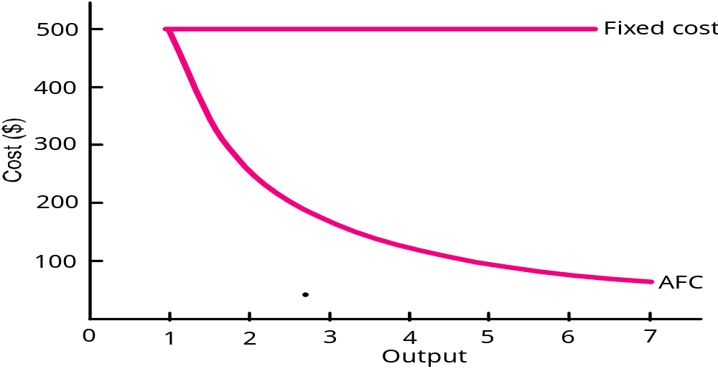
Graphing the AFC and FC Curves
Output FC VC TC AFC AVC ATC MC
0 $500 $ 0 $500 $ 0 $ 0 $ 0 $ 0
1 500 200 700 500 200 700 200
2 500 300 800 250 150 400 100
3 500 420 920 167 140 307 120
4 500 580 1080 125 145 270 160
5 500 800 1300 100 160 260 220
6 500 1200 1700 83 200 283 400
7 500 1900 2400 71 271 343 700

Slide 28
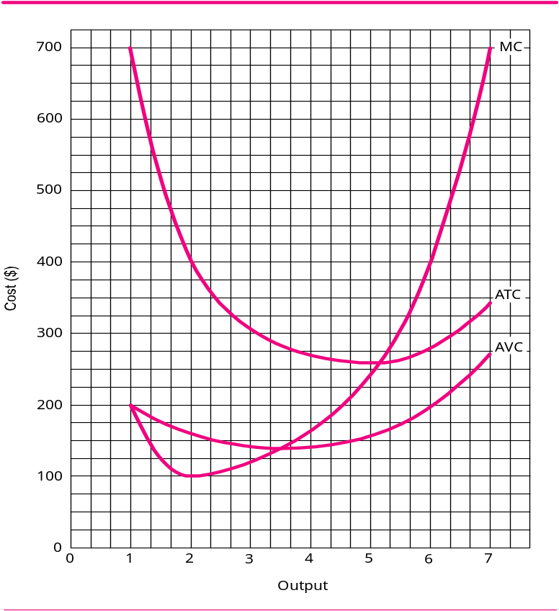
Graphing the AVC, ATC, and MC Curves
Output FC VC TC AFC AVC ATC MC
0 $500 $ 0 $500 $ 0 $ 0 $ 0 $ 0
1 500 200 700 500 200 700 200
2 500 300 800 250 150 400 100
3 500 420 920 167 140 307 120
4 500 580 1080 125 145 270 160
5 500 800 1300 100 160 260 220
6 500 1200 1700 83 200 283 400
7 500 1900 2400 71 271 343 700
The marginal cost curve intersects the ATC and AVC at their minimum points
Always do the MC curve first!

Slide 29
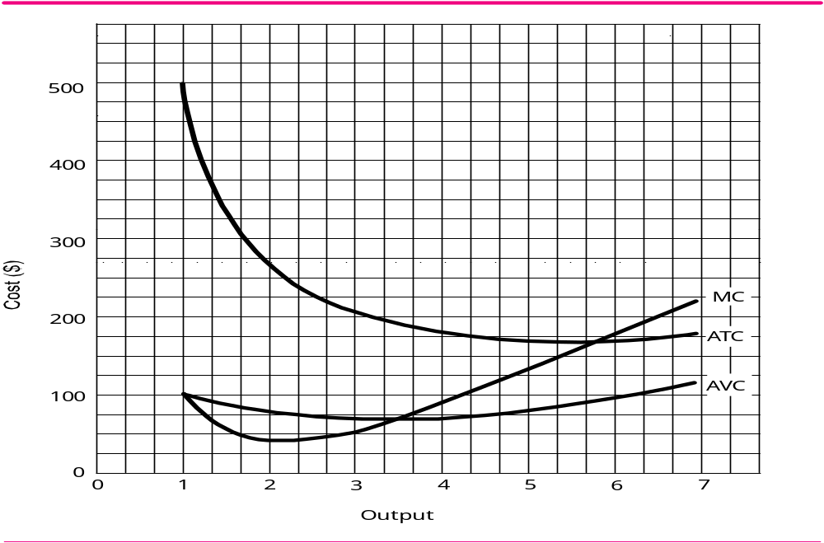
Output VC TC AFC AVC ATC MC 1 $100 $500 $400 $100 $500 $100 2 150 550 200 75 275 50 3 210 610 133 70 203 60 4 300 700 100 75 175 90 5 430 830 80 86 166 130 6 600 1,000 67 100 167 170 7 819 1,219 57 117 174 205
It is hard to tell just looking at the graph. Look at the ATC data in the table above at output levels of 5 and 6. It has to be something less than 166
What is the minimum point on the ATC?

Slide 30
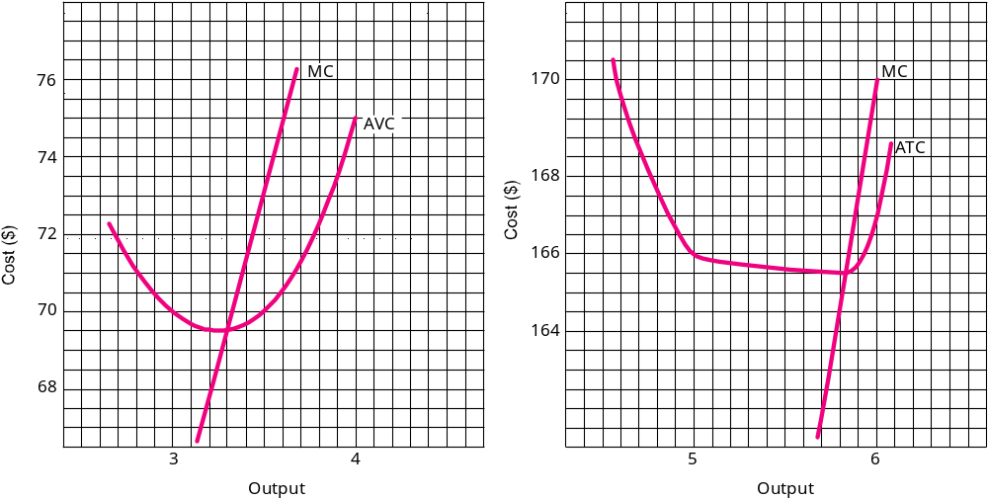
Output VC TC AFC AVC ATC MC 1 $100 $500 $400 $100 $500 $100 2 150 550 200 75 275 50 3 210 610 133 70 203 60 4 300 700 100 75 175 90 5 430 830 80 86 166 130 6 600 1,000 67 100 167 170 7 819 1,219 57 117 174 205
Minimum point on the AVC is $69.50
Minimum point on the ATC is 165.50

Slide 31

Number of Total Marginal* Workers Output Output 0 0 0 1 2 2 Increasing returns 2 5 3 Increasing returns 3 9 4 Increasing returns 4 12 3 Diminishing returns 5 14 2 Diminishing returns 6 15 1 Diminishing returns 7 15 0 Diminishing returns 8 14 - 1 Diminishing returns *Marginal output is the additional output produced by the last worker hired
The law of diminishing returns states that, as successive units of a variable resource are added to a fixed set of resources, beyond some point the extra, or marginal , product attributable to each additional unit of the variable resource will decline

Slide 32

Economies of scale are the economies of mass production, which drive down average total cost (ATC)
  Economies of scale are evidenced by the declining part of the ATC curve
In general, we expect large firms to undersell small firms because of
  Quantity discounts
  Economies of being established
  Spreading fixed cost
Economies of scale enable a business to reduce its cost per unit as output expands

Slide 33

Diseconomies of scale are the inefficiencies that become endemic in large firms
  Diseconomies of scale are evidenced by the rising part of the ATC curve
In general, at some point, the larger firms get the more inefficient they become. Reasons are:
  An expanding and growing bureaucracy
  A huge and growing corporate authority
Diseconomies of scale increase inefficiencies and also increase cost per unit

Slide 34

The overlapping forces of increasing returns and economies of scale drive down ATC
Eventually, the overlapping forces of diminishing returns and diseconomies of scale push ATC back up again
The U-shaped ATC is very important in economic analysis and in business strategy
  What size plant do we build?
  How many workers do we hire?
  What is the output at which our firm would operate most efficiently?

Slide 35

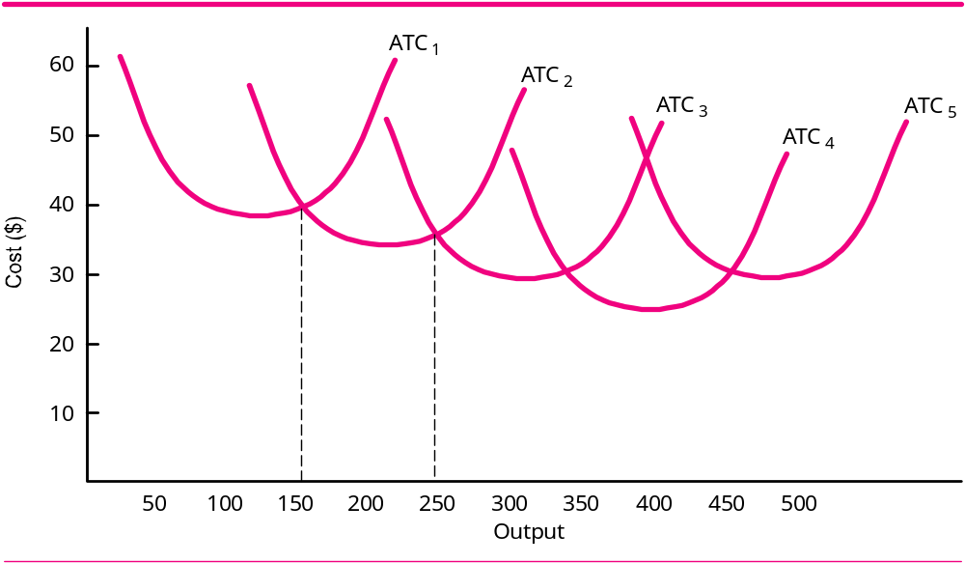
Each of these ATCs represents a different size factory, with a different optimum level of output represented by the minimum point on the ATC curve

Slide 36
ATC1 has the lowest capacity, while ATC5 has the highest capacity

Slide 37
The answer is ATC4
What size factory would a firm choose to build to produce 400 units of output?

Slide 38
Changes in the plant size are long run changes. In the long, a firm could be virtually any plant size provided it had the requisite financing

Slide 39

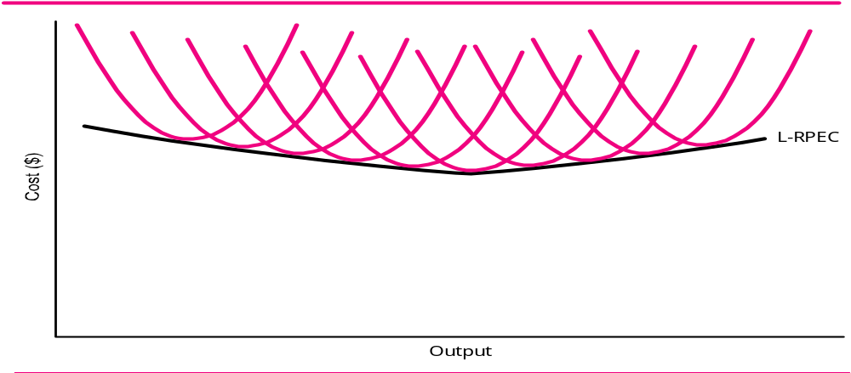
Economies of scale
Diseconomies of scale
The long-run planning envelope curve is tangent to the lowest ATC curve at its minimum point. It is tangent to most of the other ATC curves some where near their minimum points. A firm will produce at that output with a plant of that size only if that is the output at which it would mazimize prfofits

Slide 40


